Slide 1

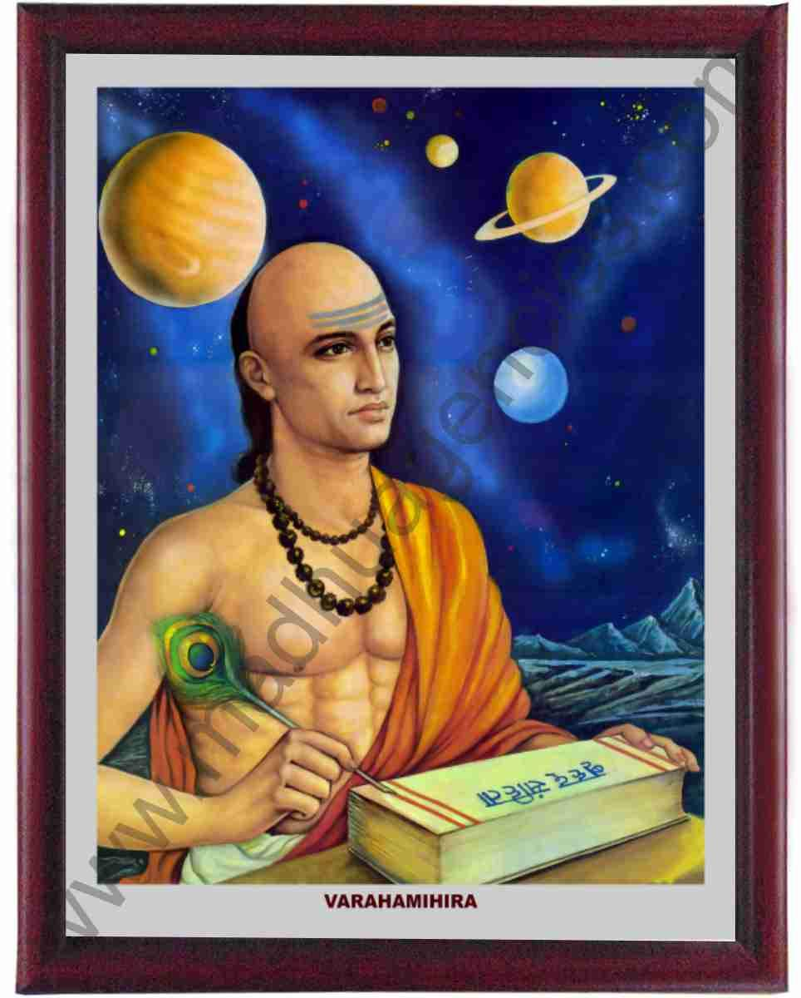
pdz %& 1- xq.kk & lw= Å/oZfr;ZXH;ke~ ¼4 vadksa dh la[;k ] vad 0 ls 9½

Slide 2
1
00:60
00:59
00:58
00:57
00:56
00:55
00:54
00:53
00:52
00:51
00:50
00:49
00:48
00:47
00:46
00:45
00:44
00:43
00:42
00:41
00:40
00:39
00:38
00:37
00:36
00:35
00:34
00:33
00:32
00:31
00:30
00:29
00:28
00:27
00:26
00:25
00:24
00:23
00:22
00:21
00:20
00:19
00:18
00:17
00:16
00:15
00:14
00:13
00:12
00:11
00:10
00:09
00:08
00:07
00:06
00:05
00:04
00:03
00:02
00:01
00:00
4 6 7 5
6 5 8 6
30 789 550

Slide 3
2
00:60
00:59
00:58
00:57
00:56
00:55
00:54
00:53
00:52
00:51
00:50
00:49
00:48
00:47
00:46
00:45
00:44
00:43
00:42
00:41
00:40
00:39
00:38
00:37
00:36
00:35
00:34
00:33
00:32
00:31
00:30
00:29
00:28
00:27
00:26
00:25
00:24
00:23
00:22
00:21
00:20
00:19
00:18
00:17
00:16
00:15
00:14
00:13
00:12
00:11
00:10
00:09
00:08
00:07
00:06
00:05
00:04
00:03
00:02
00:01
00:00
5 6 7 8
3 5 6 4
20 236 392

Slide 4
3
00:60
00:59
00:58
00:57
00:56
00:55
00:54
00:53
00:52
00:51
00:50
00:49
00:48
00:47
00:46
00:45
00:44
00:43
00:42
00:41
00:40
00:39
00:38
00:37
00:36
00:35
00:34
00:33
00:32
00:31
00:30
00:29
00:28
00:27
00:26
00:25
00:24
00:23
00:22
00:21
00:20
00:19
00:18
00:17
00:16
00:15
00:14
00:13
00:12
00:11
00:10
00:09
00:08
00:07
00:06
00:05
00:04
00:03
00:02
00:01
00:00
7 8 0 9
2 7 6 4
21 584 076

Slide 5
4
00:60
00:59
00:58
00:57
00:56
00:55
00:54
00:53
00:52
00:51
00:50
00:49
00:48
00:47
00:46
00:45
00:44
00:43
00:42
00:41
00:40
00:39
00:38
00:37
00:36
00:35
00:34
00:33
00:32
00:31
00:30
00:29
00:28
00:27
00:26
00:25
00:24
00:23
00:22
00:21
00:20
00:19
00:18
00:17
00:16
00:15
00:14
00:13
00:12
00:11
00:10
00:09
00:08
00:07
00:06
00:05
00:04
00:03
00:02
00:01
00:00
3 8 7 5
8 2 4 4
31 945 500

